Slide 1

CSE 464 : Software Quality Assurance and Testing
Introduction to Model Based Testing
Janaka Balasooriya

Slide 2
Model Based Testing : Finite State Model
Definition of Finite State Machines
When to use
How to design test cases using model based testing

Slide 3
Finite Sate Model Based Testing Example 1
Develop a finite state model that detects the pattern 1011 and design test cases. Assume that software reads one bit at a time.

Slide 4
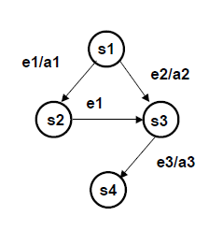
Finite State Model
Finite State Machines (FSM)
• A Finite State Machine (FSM) is a directed graph in which nodes are states and edges are transitions
• States can be used to represent
  – Conditions
  – Stages of processing
• Transitions are caused by
  – Events
  – Data
  – Passage of time
• A well-formed FSM has one initial state and one final state
• Paths from the initial to the final state are test cases

Slide 5
FSM Notation
• States are circles
– s1, s2, s3, s4
• Events (e1, e2, e3)
• Actions (a1, a2, a3)
• Transitions are arrows
• Transition notation: the transition from s1 to s2 is caused by event e1, and generates action a1.
• e1 is a context-sensitive input event

Slide 6
Deterministic and Non-Deterministic Nature of FSM
Two Definitions of “Deterministic”
• A program (or model) is deterministic if:
  – 1. Given the same input, it always produces the same output
  OR
  – 2. Given the same input, it always produces a predictable output.
• A non-deterministic model cannot be tested using this technique.
• Why?

Slide 7
Test Coverage Based on Finite State Machines
Develop a set of test cases, such that:
  Random Walk
  Weighted Traversal
  Shortest Path
  Every state is traversed
  Every transition is traversed

Slide 8
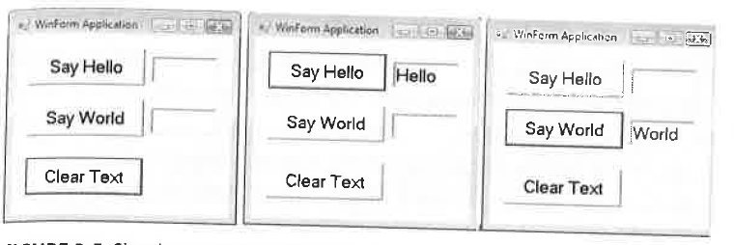
Finite State Model Example 2: Hello World Program
Reference : How we test at Microsoft

Slide 9
Program to Finite State Model
Reference : How we test at Microsoft

Slide 10
Test Cases for the HelloWorld Example
Reference : How we test at Microsoft

Slide 11
Finite State Model Based Testing Example 3
ATM Machine Example: In this example, we will be developing the FSM based testing for the withdrawal function of the ATM Machine.
Certain ATM machine is expected to behave as follows: While withdrawing money, first, user enters the card. If the card is valid, then the user will be prompted to enter the PIN. Invalid cards will be returned by the machine. If the user enter an invalid PIN for three times the card will be kept by the ATM machine. Otherwise, the user will be prompted to enter the withdrawal amount. If sufficient balance money will be dispensed and the card will be returned.

Slide 12
Next Time
Introduction to Bug Management

